Slide 1



Forecasting NYC 911 Ambulance Call Volume
Data-Driven Insights for Smarter Emergency Response
Prepared by:
MD A RAHMAN RUHEL
Data Analyst | Data Science Fellow @ Springboard

Slide 2




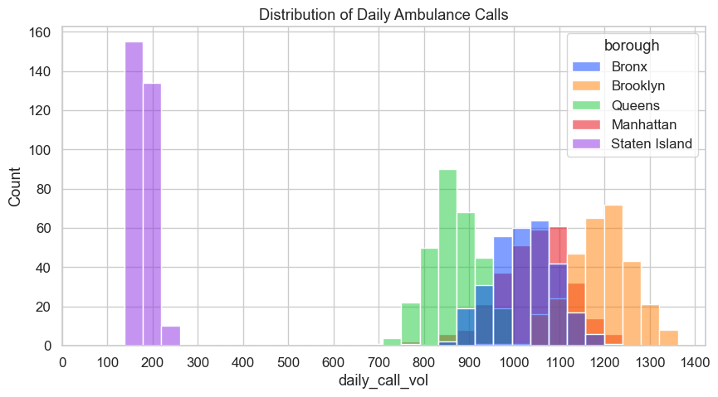
NYC EMS at a Glance
The NYC Emergency Medical Services (EMS) system responds to over 1.6 million emergency incidents annually, averaging 4,400–4,800 ambulance calls per day across New York City.
On peak days, call volume can exceed 5,000 daily calls, making it one of the busiest EMS systems globally.
Fluctuations are influenced by seasonality, weather, population density, and special events.

Slide 3




Goal of the Study:
To forecast daily 911 ambulance call volumes to support:
Optimal staffing and resource allocation
Faster response times during peak demand
Data-driven operational planning for EMS Service

Slide 4



Project Objectives:
1
Build predictive models for daily ambulance call volumes.
Compare two modeling strategies:
Citywide model (XGBoost & Linear Regression)
Borough-wise models (XGBoost & Prophet)
2
3
Identify operational insights for better resource allocation.

Slide 5




Data Collection & Sources:
Primary: NYC Open Data – Ambulance Call Volumes (July 2024 – April 2025) https://data.cityofnewyork.us/resource/76xm-jjuj.json
Additional:
Weather data (temperature & conditions)
Holiday calendar
Temporal features (day-of-week, lagged volumes, rolling averages)

Slide 6

Data Preparation & Feature Engineering
Cleaned null/inconsistent entries
Converted timestamps to daily resolution
Created lag & rolling features (lag_1, lag_2, roll_3, roll_7, week_diff)
One-hot encoded categorical variables (boroughs, severity)

Slide 7

Data Overview
Final Data after feature Engineering
date | borough | daily_call_vol | mean_ severity_ level | max_ severity_ level | min_ severity | day_of_week | is_weekend | is_holiday | lag_1 | lag_7 | precp | snowfall | temp | lag_2 | lag_diff_1 | week_diff | roll_3 | roll_7
7/1/24 | Bronx | 1039 | 4.216554 | 1 | 8 | 0 | 0 | 0 | 1021.557 | 1020.562 | 0.4 | 0 | 70.34 | 984 | -3 | -0.9954 | 996.6667 | 1001.714
7/8/24 | Bronx | 1134 | 4.194885 | 1 | 7 | 0 | 0 | 0 | 1009 | 1039 | 0 | 0 | 82.04 | 1049 | -40 | 30 | 1052.333 | 1007.857
7/15/24 | Bronx | 1230 | 4.162602 | 1 | 8 | 0 | 0 | 0 | 1070 | 1134 | 1.6 | 0 | 82.04 | 995 | 75 | 64 | 1028.667 | 1072.857
7/22/24 | Bronx | 1137 | 4.186456 | 1 | 8 | 0 | 0 | 0 | 1091 | 1230 | 3.3 | 0 | 76.19 | 994 | 97 | 139 | 1048 | 1082

Slide 8

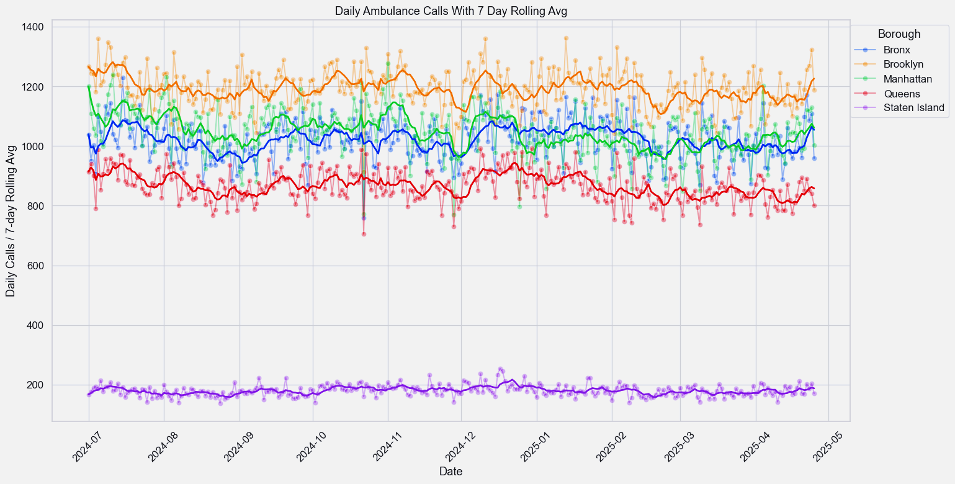
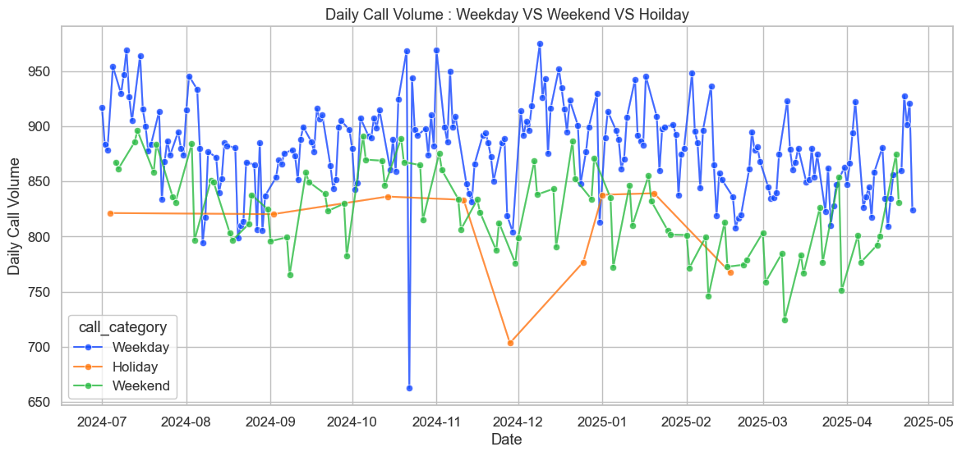
Exploratory Data Analysis (EDA)
Manhattan & Brooklyn report the highest daily calls.
Weekdays have higher call volumes than weekends/holidays.

Slide 9
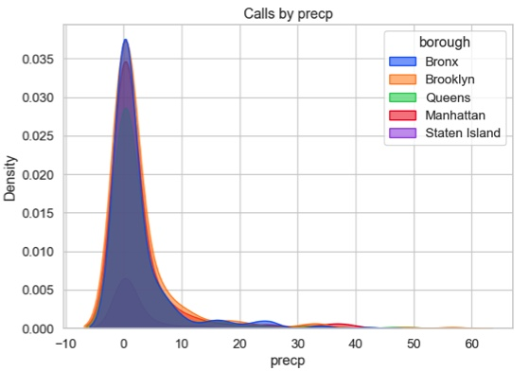
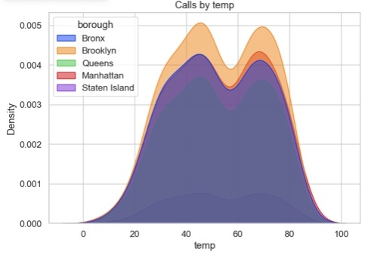
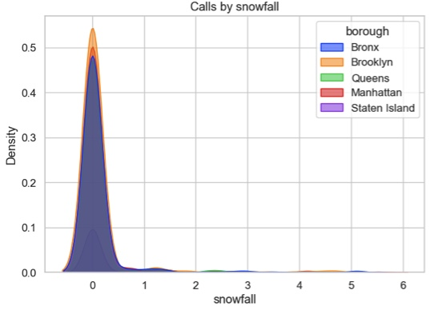
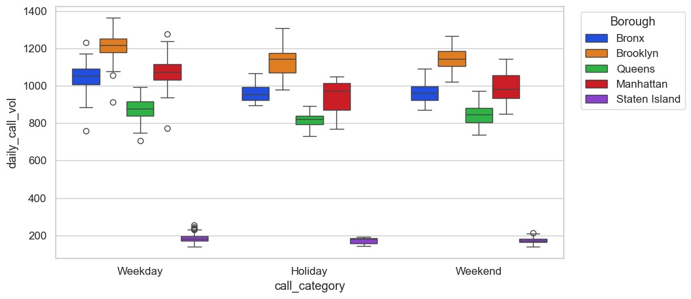
Exploratory Data Analysis (EDA)
Density distributions of Temperature, precipitation, and snowfall reveals clear clusters and nonlinear effects..
Distribution within IQR is consistent; few outliers in high-volume boroughs.

Slide 10

Train/Test Split and Scaling Decisions:
The dataset (July 2024 – April 2025) is divided chronologically to respect the time-series nature of EMS call data.
Training set :
Test set :
Validation set :
~7 months (July 2024 - Feb 2025)
Used to fit the model and learn historical patterns.
~1 month (April 2025)
Final unseen data to evaluate how the model performs on truly new future calls.
~2 months ( Feb/March 2025)
Held out for hyperparameter tuning and model selection.

Slide 11

Modeling Framework
The Project explored two separate model strategies: Framework:
Citywide Model
Aggregated all boroughs together
Served as a baseline to understand overall demand trends
Models tested: Linear Regression, XGBoost
Final selection: XGBoost
Borough_wise Model
Separate model trained for each borough
Captures local patterns & variability
Models tested: Linear Regression, Prophet, XGBoost
Final selection: XGBoost for each borough (best accuracy)
Data Ingestion
Feature Extraction
Model training
Prediction
City Wide
Borough wise
EDA
Preprocessing

Slide 12
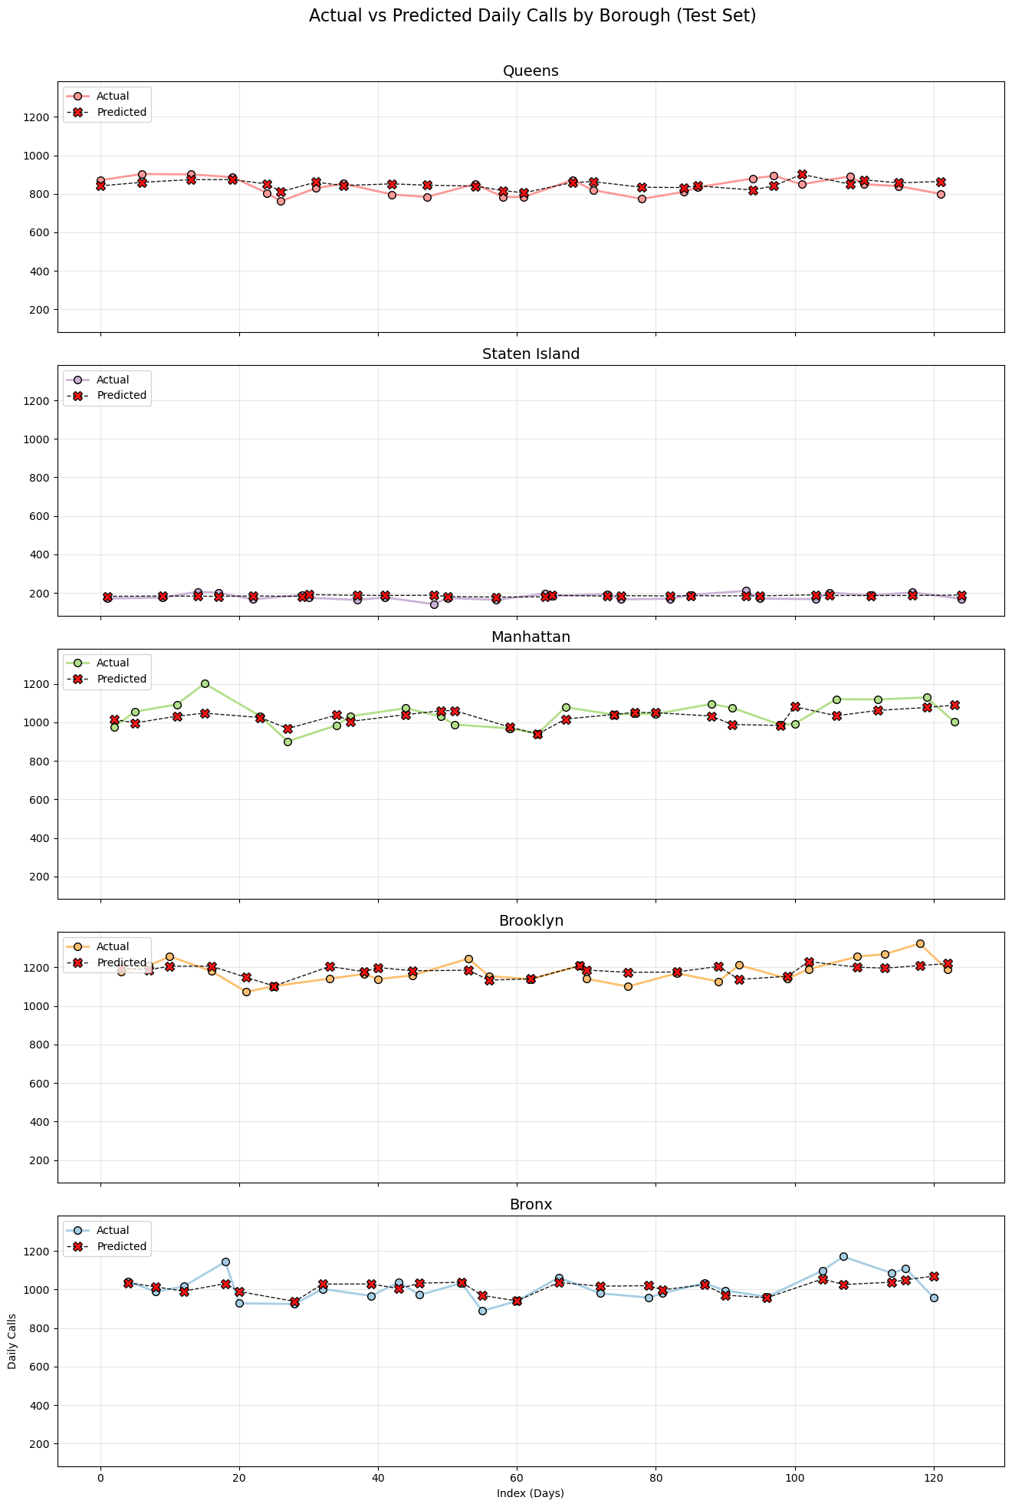
Citywide model Results
XGBoost
RMSE: | 47.84
MAE | 36.93
R² | 0.98
MAPE: | 5.09%
Linear Regression
(Baseline model)
Avg RMSE | 62.90
Insights:
Captures nonlinear patterns effectively.
Residuals centered near zero; slight heteroscedasticity.
Lag and rolling features most influential (per SHAP).

Slide 13

Model Hyperparameter Tuning
The XGBoost model was fine-tuned using RandomizedSearchCV
to optimize RMSE and prevent overfitting.
Parameters | Value
n_estimators | 100
max_depth | 3
learning_rate | 0.05
subsample | 0.6
colsample_bytree | 0.6

Slide 14
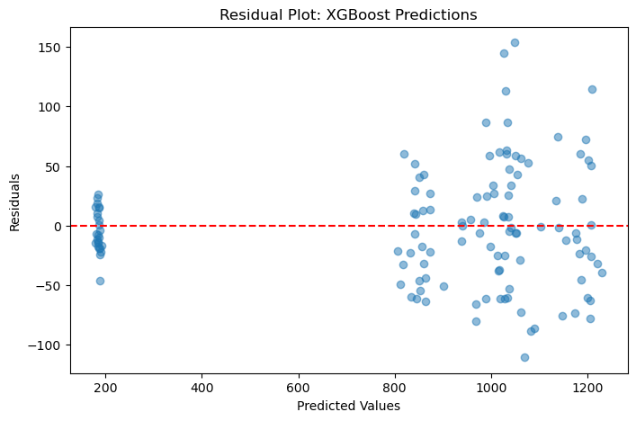
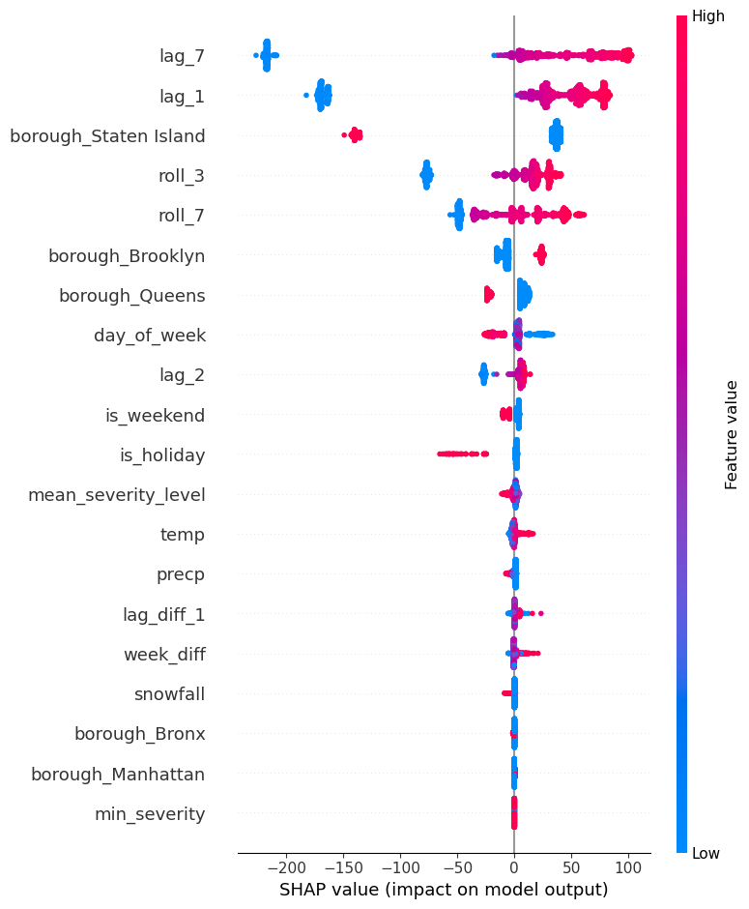
Model Diagnostics & Feature Insights
Residual Plot
SHAP Feature Importance
Residual analysis shows that errors are centered around zero, indicating no systematic bias.
The SHAP analysis revealed that lag features and rolling features were the most influential predictors.

Slide 15
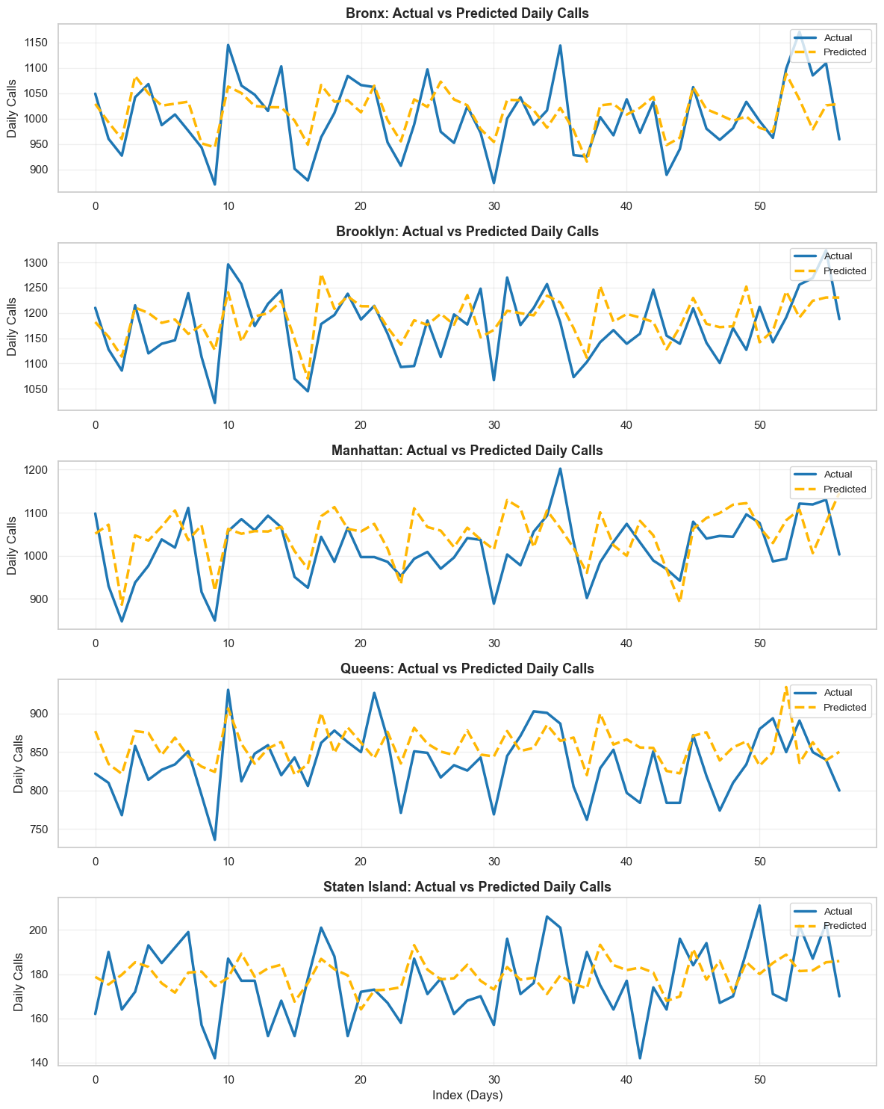
Borough-Wise model Results
Borough | RMSE (XGBoost) | R² (XGBoost) | RMSE (Prophet) | R² (Prophet)
Bronx | 55.32 | 0.38 | 58.01 | 0.29
Brooklyn | 58.59 | 0.18 | 62.91 | -0.09
Manhattan | 72.94 | -0.09 | 72.42 | -0.19
Queens | 44.07 | -0.13 | 43.79 | -0.15
Staten Island | 16.88 | -0.10 | 20.25 | -0.53

Slide 16
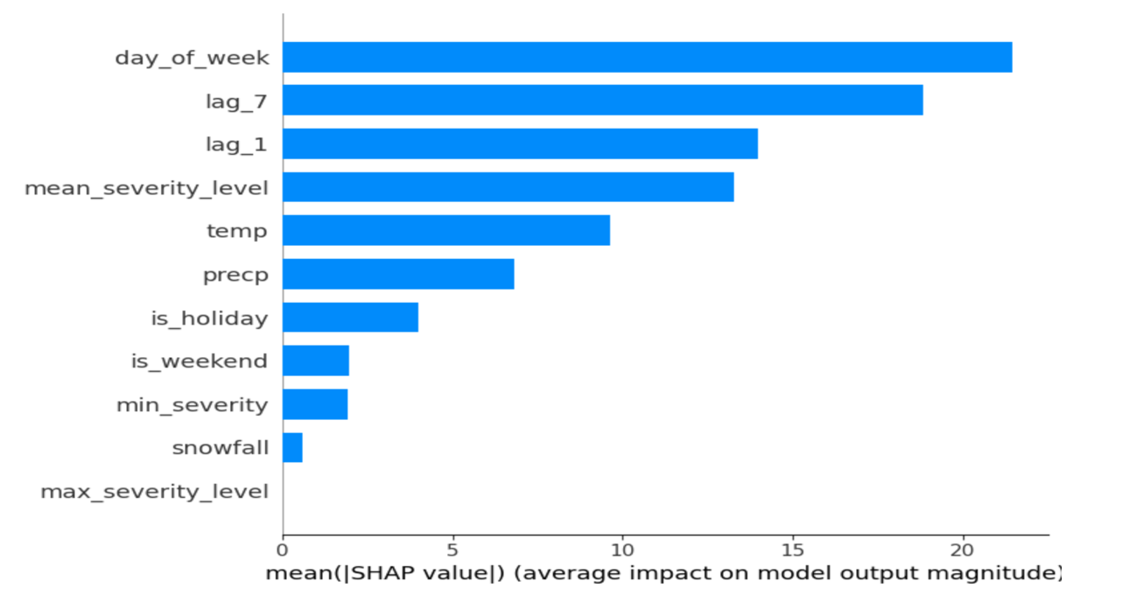

Model Diagnostics & Feature Insights
SHAP Feature Importance
Day of the week, temperature, lag call volume, and mean severity level emerge as the most important predictors,
Insights:
XGBoost outperformed Prophet across most boroughs, capturing local demand patterns more accurately.
Manhattan showed highest variability, while Staten Island was most stable, reflecting differences in call volume and predictability.

Slide 17

Future Improvements
Additional Features: Incorporate external factors such as public events, demographics, population density or traffic conditions to improve prediction of short-term demand spikes.
Advanced Temporal Models: Explore deep learning approaches like LSTM or Temporal Fusion Transformers.
Data Granularity: Use finer-grained spatial or temporal data (e.g., neighborhood-level or hourly call data) to improve local accuracy.
Visualization & Dashboard: Develop an interactive dashboard for real-time monitoring of forecasts, residuals, and feature contributions to support operational decision-making.

Slide 18


Conclusion
The citywide XGBoost model demonstrated strong overall performance (RMSE 47.84, R² 0.98, MAPE 5.09%), significantly outperforming the linear regression baseline.
Borough-level XGBoost models captured local trends and outperformed Prophet benchmarks, though performance varied due to differences in data volume and variability, with Manhattan showing the highest prediction error.

Slide 19


THANK YOU

